Slide 1
Cardiogenic Shock: Can New Hemodynamic Measurements Help RT’s Treat Patients?
Jeff Davis, RRT-NPS, RCIS

Slide 2
Disclosure Statement of Financial Interest
I, Jeff Davis, DO NOT have a financial interest/arrangement or affiliation with one or more organizations that could be perceived as a real or apparent conflict of interest in the context of the subject of this presentation.

Slide 3
Objectives
Describe the hemodynamic criterion of cardiogenic shock
Differentiate primary right side vs. left side cardiogenic shock based on hemodynamics
Describe the significance of Cardiac Power Output (CPO) and Pulmonary Arterial Pulsatility Index (PAPi) for patients in cardiogenic shock

Slide 4
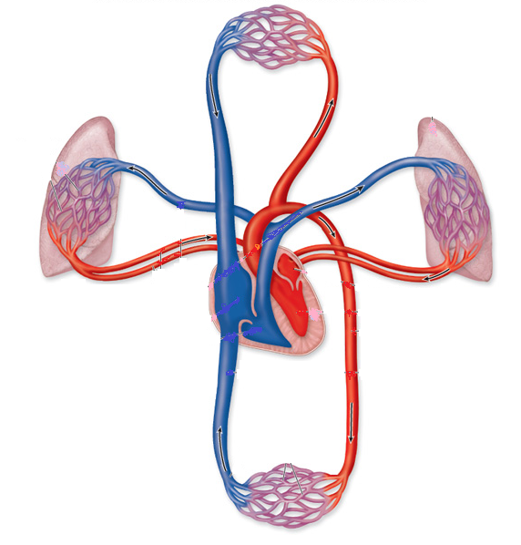
Shock—”by any other name…”
Hippocrates perhaps first to describe shock
French surgeon Henri Francois Le Dran was the first person to use the term shock in 1737
“The rude unhinging of the machinery of life” – Samuel Gross, 1872
End-organ cellular dysfunction due to tissue hypoperfusion
Cardiogenic, Hypovolemic, Obstructive, Distributive (Anaphylactic, Septic, Neurogenic)

Slide 5
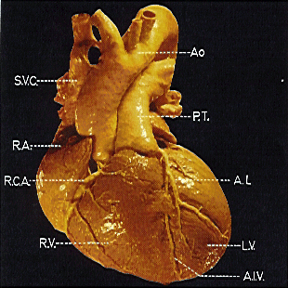
Cardiogenic Shock
The impaired ability of the heart to pump blood
Pump failure of the left or right ventricle
Most common cause is LV MI (Anterior)
Occurs when > 40% of ventricular mass damage
Mortality rate of 50 % or >

Slide 6
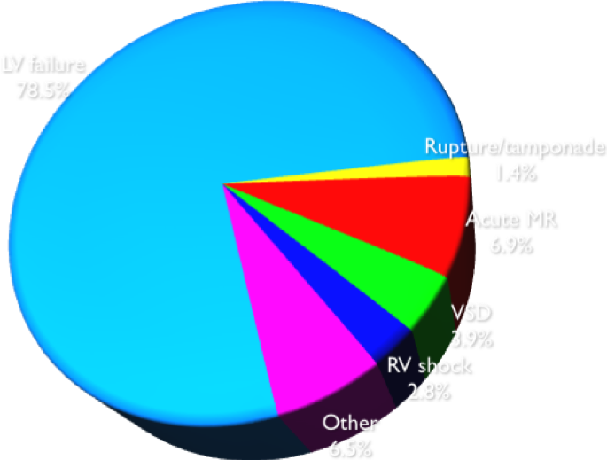
Etiologies of Cardiogenic Shock
ACS, STEMI, NSTEMI
LV Failure, RV failure
Mechanical Complications
MR, VSD, Rupture, Tamponade
Advanced Heart Failure

Slide 7
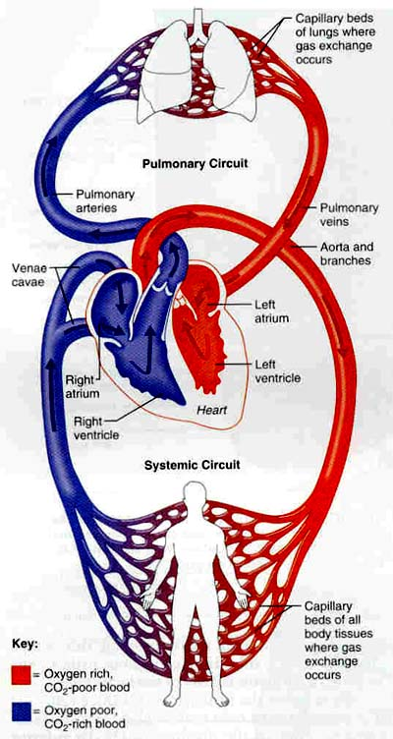
CLINICAL ASSESSMENT
Pulmonary & Peripheral Edema
JVD
Tachycardia, Tachypnea,
Crackles
Dec. PaO2
Dec. Urine Output
Dec. LOC
Hemodynamics
Dec CO/CI, MAP
Inc. PCWP, PA, CVP, SVR

Slide 8
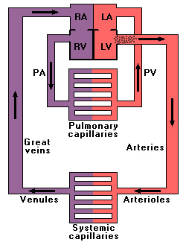
Hemodynamic Basis For Signs & Symptoms
Increase: LVEDP, LA, PCWP, PAP
Decrease: CO/CI
Chronic Increase RHP
Dr. Philip B. Adamson
Notes:
Animated slide (works in slide show):
In this schematic, notice when the LVEDP rises due to an increase in LV end diastolic volume (mouse click to add arrow), and it causes the left atrial pressure to rise (mouse click), which causes elevated pressures in the lungs (mouse click). This elevated pulmonary pressure causes fluid to seep out of the pulmonary capillaries, and causes pulmonary congestion. This pulmonary congestion causes the patient to be short of breath.
Slide courtesy of Dr. Philip B. Adamson, Director, Congestive Heart Failure Treatment Program University of Oklahoma, Oklahoma City, OK

Slide 9
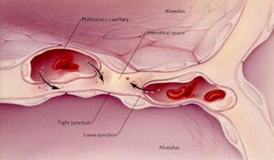
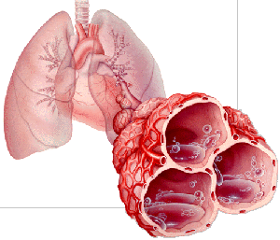
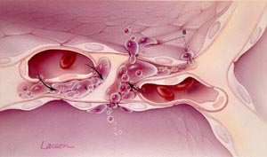
Left Heart Failure Leading to Pulmonary Edema

Slide 10
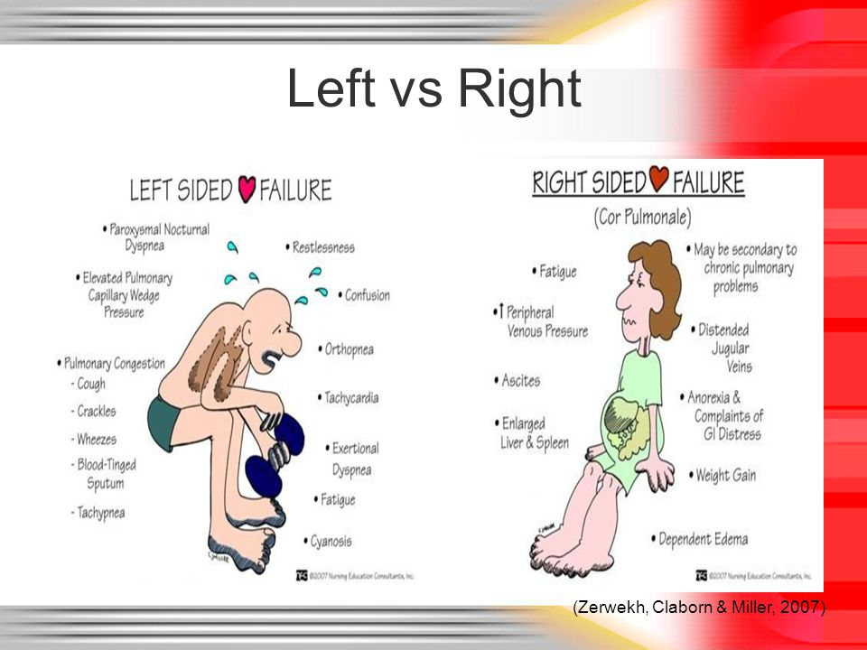
Inc: LVEDP, LA/PCWP, PAP
Dec: CO/CI
Chronic Case Inc. Right Heart Pressures
Inc: RVEDP, RA/CVP, JVP
Pos Dec: PAP, PCWP, CO/CI
Notes:
It is important to understand that the symptoms of systolic and diastolic heart failure are the same. Whether a patient has systolic or diastolic heart failure depends on the ejection fraction. If the EF is less than 40%, it is labeled systolic heart failure. If it is greater than 40%, it is labeled diastolic heart failure. Remember that almost all systolic heart failure has a component of diastolic failure.
Patient symptoms must correlate to the physical signs in order for them to be diagnostic of heart failure.
The symptoms of left ventricular dysfunction and the physical signs are all resultant of increased left arterial pressure, capillary pressure, and pulmonary congestion.

Slide 11
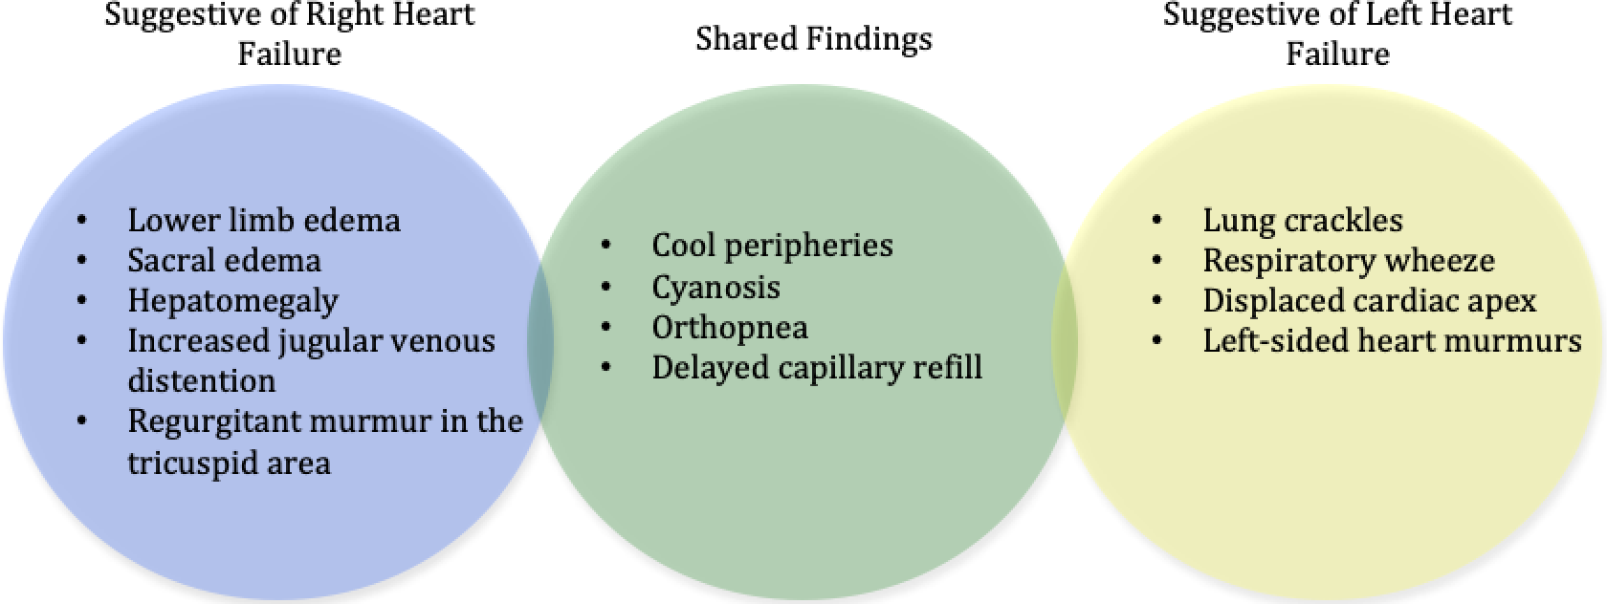
Cardiogenic Shock, Volume: 8, Issue: 8, DOI: (10.1161/JAHA.119.011991)

Slide 12
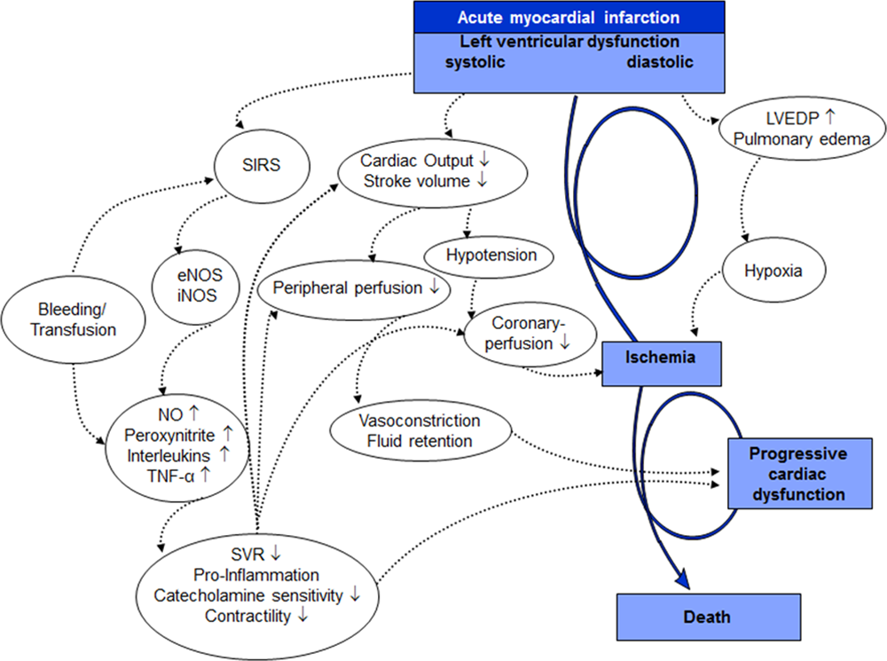
Contemporary Management of Cardiogenic Shock: A Scientific Statement From the American Heart Association, Volume: 136, Issue: 16, Pages: e232-e268, DOI: (10.1161/CIR.0000000000000525)

Slide 13
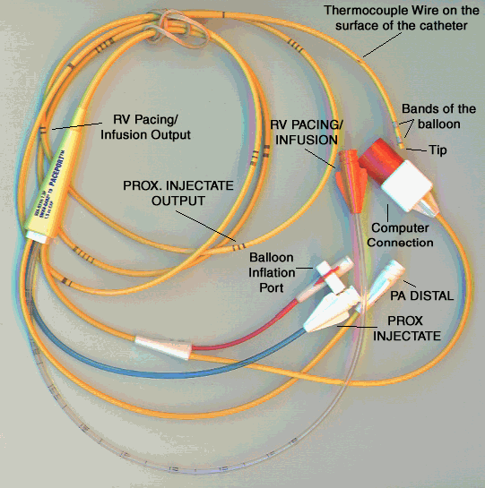
The Case for Right Heart Caths
Cardiogenic shock most common cause of in-hospital mortality after AMI, rates > 50% for nearly 2 decades
Short-term stabilizing effects of vasopressors/inotropes offset by adverse effects on afterload and oxygen demand, resulting in end-organ hypoperfusion, lactic acidosis, and refractory shock
Recent scientific statement by the AHA suggests that RHC may play important roles in the diagnosis/management of CS
Not all CS cases are the same

Slide 14
What are we monitoring?
LEFT HEART
4. PCWP = 5. Left atrial Pressure (8-12 mmHg)¹
6. LVEDP (5-12 mmHg)²
7. CO (4-7 L/min) via thermodilution (TD) or CCO PA Catheter³
8. Blood Pressure (100-140/60-90 mmHg)³
CALCULATED DATA
MAP (70-100 mmHg)=2/3*Diastolic Pressure + 1/3*Systolic Pressure³
CO (4-7L/min)= FICK eqn = (BSA ×120)/
0.1 × 1.36 × (SaO₂-SvO₂) × Hgb³
CI (2.5-4.5L/min/m²) = CO/BSA³
L Heart pumps against the SVR (SVR 800-1200dynes*sec/cm-5) = 80* (MAP-CVP)/CO³
CPO (>0.6 Watts) = CO*MAP*0.0022^{5,6}
RIGHT HEART
1. RAP +/or CVP (0-8 mmHg)¹
2. RV Systolic/Diastolic (15-30/0-8 mmHg)¹
3. PA Systolic/Diastolic (15-30/8-12 mmHg)¹
3. SVO₂ (70-75%)^{3,4}
CALCULATED DATA
Right heart pumps against PVR (120-250 dynes*sec/cm⁻⁵)
= 80*(mean PA-PCWP)/CO³
PAPi > 1.0 (PASP-PADP)/CVP
4
7
3
5
1
8
6
2
Marso SP, Griffin BP, Topol EJ. Manual of Cardiovascular Medicine. Philadelphia: Lippincott Williams & Wilkins, 2000.
Kern MJ. The Cardiac Catheterization Handbook, 4th ed. St. Louis: Mosby Inc; 2003.
Carey CF, Lee, HH, Woeltje KF. The Washington Manual of Medical Therapeutics, 29th ed. Philadelphia: Lippincott-Raven Publishers, 1998.
Marino PL. The ICU Book, 2nd ed. Baltimore: Williams & Wilkins, 1998.
Naidu S, et al. Circulation. 2011;123(5):533-543.
Fincke J, et al. J Am Coll Cardiol. 2004;44:340-348.
Salvatore F Mannino, DO, MA, FACC, FSCAI

Slide 15
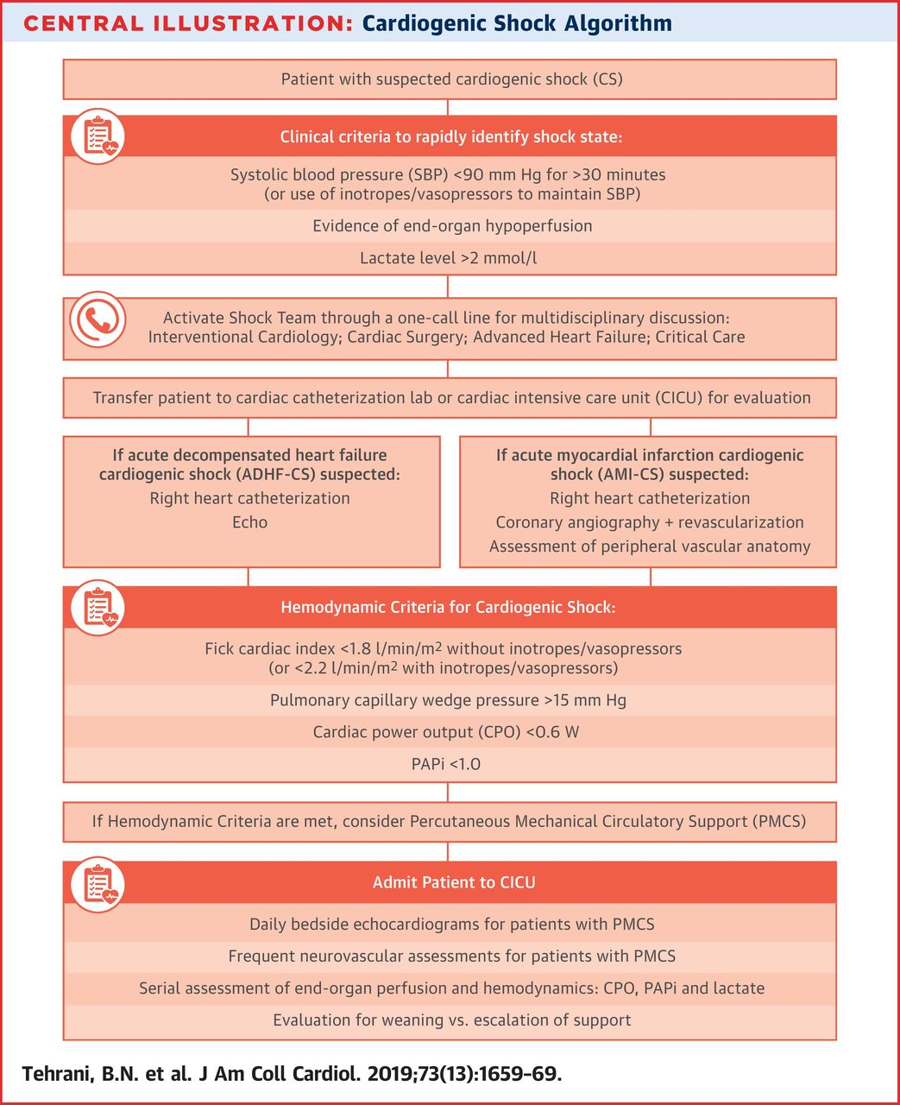
Cardiogenic Shock Criteria
SBP < 90 mmHg for > 30 minutes
(or inotropes/pressors to maintain SBP >90)
Evidence of end-organ hypoperfusion
Lactate > 2 mmol/L
Fick CI < 1.8 L/min/m² w/o inotropes/vasopressors or <2.2 with inotropes/vasopressors
PCWP > 15 mmHg (18); RVEDP > 10-15 mmHg
Cardiac Power Output (CPO) < 0.6 W
Pulmonary Arterial Pulsatility Index (PAPi) < 1.0

Slide 16
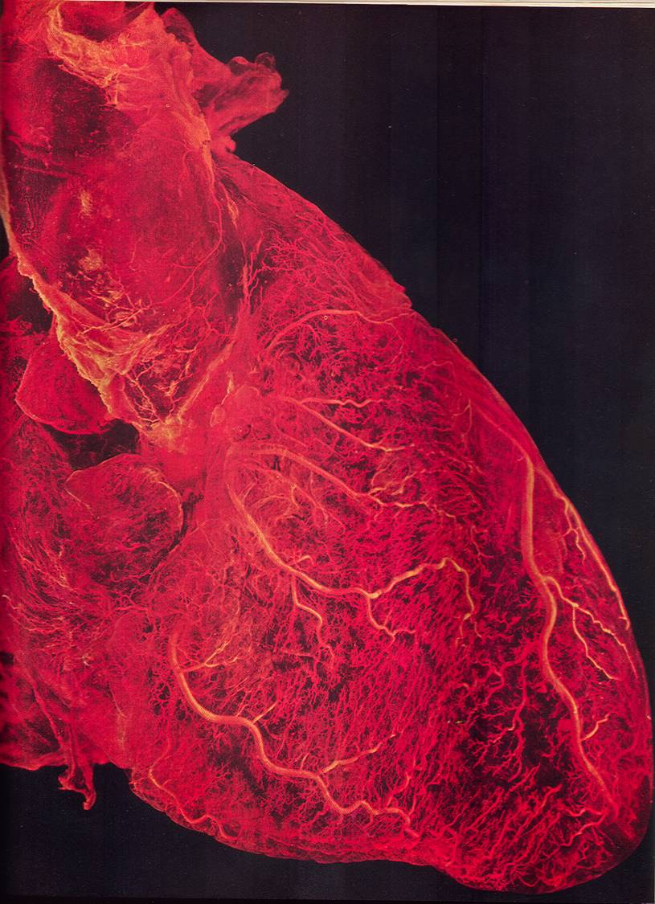
Cardiogenic Shock : Complications
Anterior/Septal MI
Ventricular Septal Defect
Mitral Regurgitation
Complete Heart Block
Inferior MI
Right Ventricular Involvement
Ventricular Septal Defect
Mitral Regurgitation
2nd Degree Type 1 Heart Block
Arrhythmias
Cardiac Arrest
Ventricular Aneurysm/Rupture

Slide 17
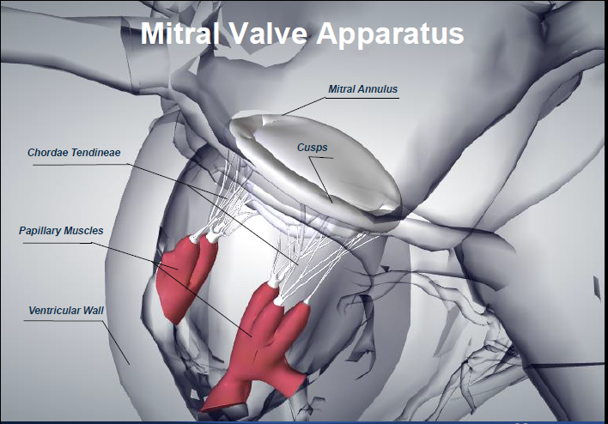
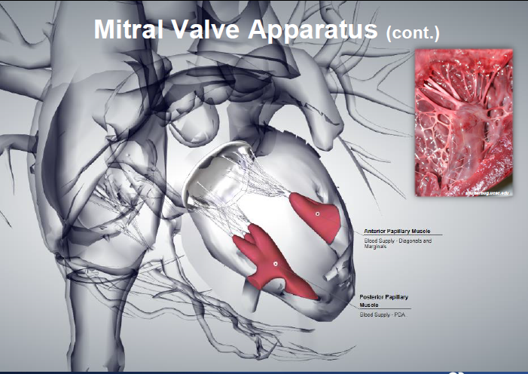
Mitral Valve Structure

Slide 18
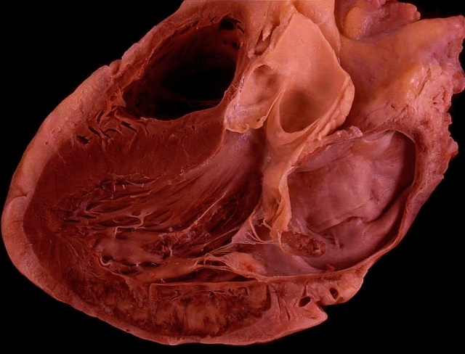
Acute Mitral Regurgitation
1-2% of AMI’s
50% small MI’s
20% first 24 hours, average is 3-7 days
More common in inferior/inferoposterior than anterior MI’s
Inc. PCWP (V waves), PA
Dec. AO, CO,
murmur,
Michael Ragosta, MD, www.cardioVillage.com

Slide 19
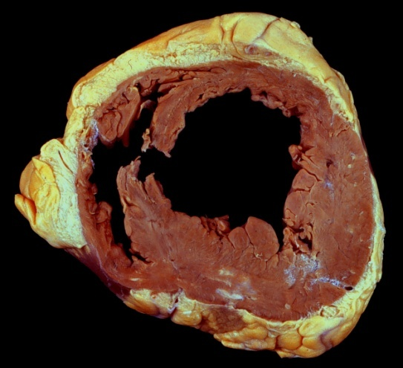
Ventricular Septal Rupture
1%-3% of infarctions
Likelihood about equal anterior and inferior MI’s
Both LAD and PDA feed septal wall
Typically, first infarction w/o collaterals
Peak occurrence 3-5 days, but can be in first 24 hours
Inc. RV and PA SO2, murmur
Michael Ragosta, MD, www.cardioVillage.com

Slide 20
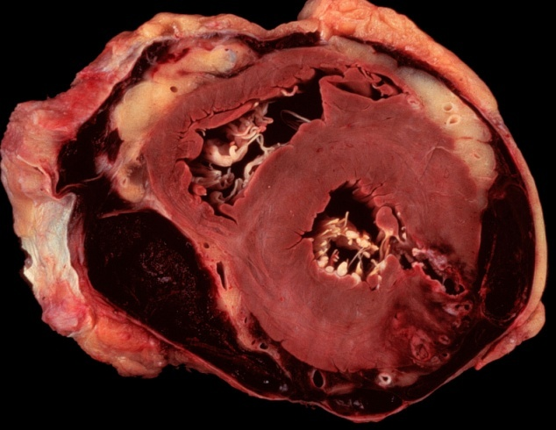
Free Wall Rupture
Risk factors:
Advanced age
Females
Hypertension
First MI
Corticosteroids
1-2% of MI’s
30% in first 24 hours, most by 7 days
Tamponade (Dec. AO, Inc. CVP, Dec. heart sounds)
Michael Ragosta, MD, www.cardioVillage.com

Slide 21
Right Ventricular Infarction
Associated with 40-50% of inferior infarcts
Approximately ½ of patients with RCA occlusion have a RV infarction
Higher mortality for inferior MI’s with RV involvement
Clinical features vary
Asymptomatic to hypotension and shock
Michael Ragosta, MD, www.cardioVillage.com

Slide 22
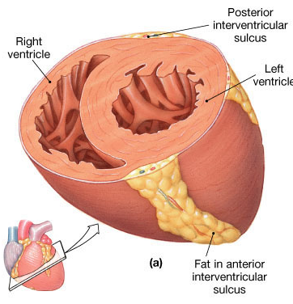
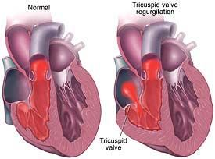
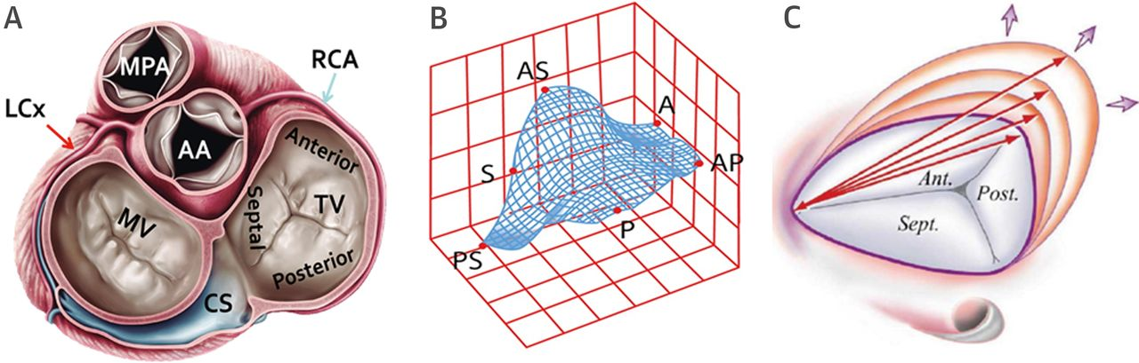
COPD and Pulmonary HTN Can lead to Tricuspid Regurgitation

Slide 23
Cardiac Power Output (CPO)
Assesses left heart (flow & SVR)
CPO = (MAP x CO)/451
CPO = (93x5)/451
CPO = 465/451
CPO = 1.03 Watts
CPO < 0.6 Watts indicate left side mechanical support may help

Slide 24
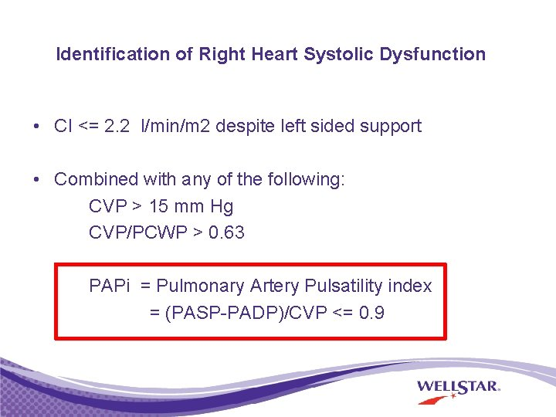
Pulmonary Arterial Pulsatility Index (PAPi)
Marker of Right Heart Dysfunction
PAPi = (PAsys – PAdias)/RA
PAPi = (25-8)/4
PAPi = 17/4
PAPi = 4.25
PAPi < 1.0 indicate right side mechanical support may help
Pulmonary Artery Catheterization and the Management of Cardiogenic Shock. Salvatore F Mannino, DO, MA, FACC, FSCAI.
Kochav SM, Flores RJ, Truby LK, Topkara VK. Prognostic Impact of Pulmonary Artery Pulsatility Index (PAPi) in Patients With Advanced Heart Failure: Insights From the ESCAPE Trial. J Card Fail. 2018 Jul;24(7):453-459. doi: 10.1016/j.cardfail.2018.03.008. Epub 2018 Mar 27. PMID: 29597051.

Slide 25
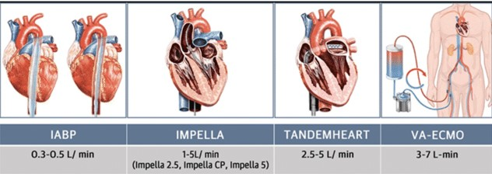
Mechanical Support Options

Slide 26
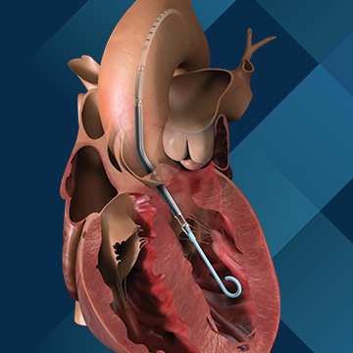
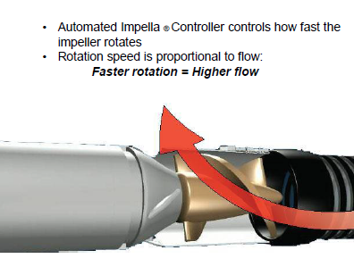
Outflow
Inflow

Slide 27
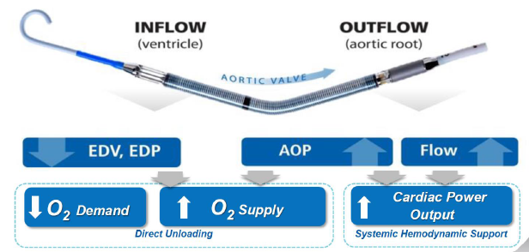
Impella Support Physiological Results

Slide 28
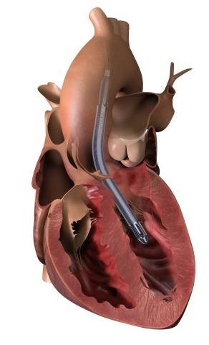
Left Ventricular Mechanical Support
Depending on device provides 2.5-5.0 LPM flow. Percutanous or cutdown via femoral artery
Pulls blood from an inlet near the tip of the catheter in LV and expels blood into the ascending aorta
Pulse ox may not work due to no pulse if on max support
https://www.abiomed.com/products-and-services/impella/impella-25?wvideo=5n4m79b6f7

Slide 29
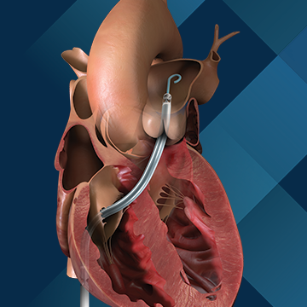
Right Ventricular Mechanical Support
Temporary support for RV failure via femoral vein
Max flow > 4 lpm
Pulls blood from an inlet near in the IVC and expels blood into the pulmonary artery
https://www.abiomed.com/products-and-services/impella/impella-rp-with-smartassist?wvideo=i8ksvg3xqj

Slide 30
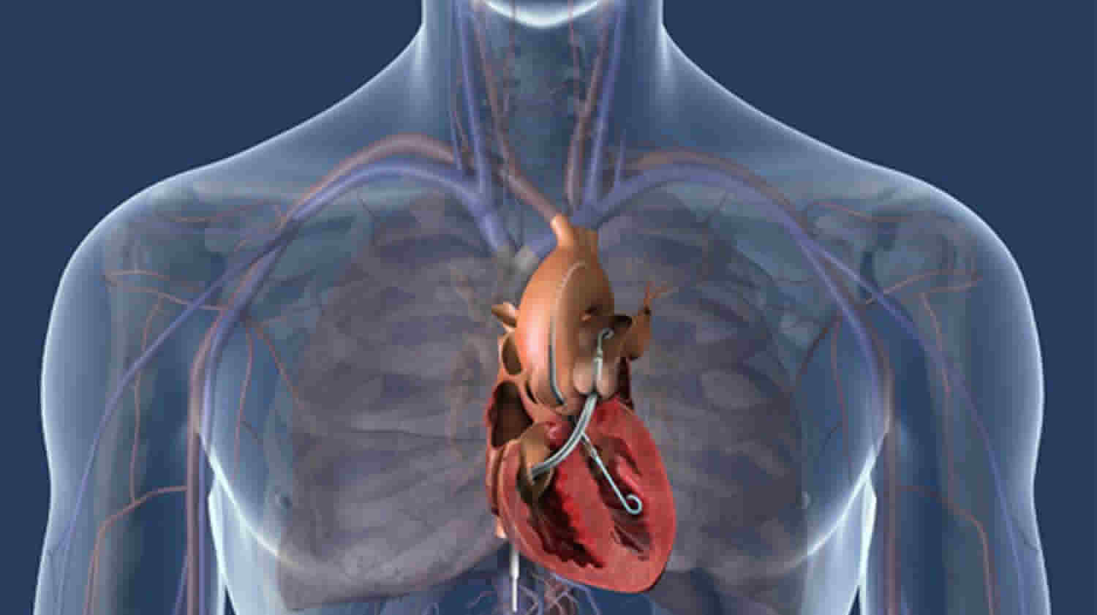
Biventricular Mechanical Support

Slide 31
Case Study
64 yo male STEMI
Hx: HTN, COPD, DM, PAD, CKD
Presenting with SOB & HF
Troponin 1.4 ng/L
Cr 1.4 mg/dL
BP 88/56 mmHg on dopamine drip
Bedside echo 15-20% EF
Hemodynamics
MAP 60 mmHg
CO 2.8 L/mln, CI 1.4 L.min.M2
RA/CVP 20mmHg
PA 54/32 mmHg
LVEDP 34 mmHg
CPO = 60 x 2.8 / 451 = 0.4
PAPi = (54 – 32) / 20 = 1.1

Slide 32
Case Study
64 yo male STEMI
Hx: HTN, COPD, DM, PAD, CKD
Presenting with SOB & HF
Troponin 1.4 ng/L
Cr 1.4 mg/dL
BP 88/56 mmHg on dopamine drip
Bedside echo 15-20% EF
Hemodynamics
MAP 60 mmHg
CO 2.8 L/mln, CI 1.4 L.min.M2
RA/CVP 20mmHg
PA 54/32 mmHg
LVEDP 34 mmHg
CPO = 60 x 2.8 / 451 = 0.4
PAPi = (54 – 32) / 20 = 1.1

Slide 33
How Would You Treat?
A) Immediate Coronary Intervention
B) Immediate CAGB Surgery
C) Right Side Mechanical Support (Right Impella)
D) Left Side Mechanical Support (Left Impella)
E) Admit to ICU

Slide 34
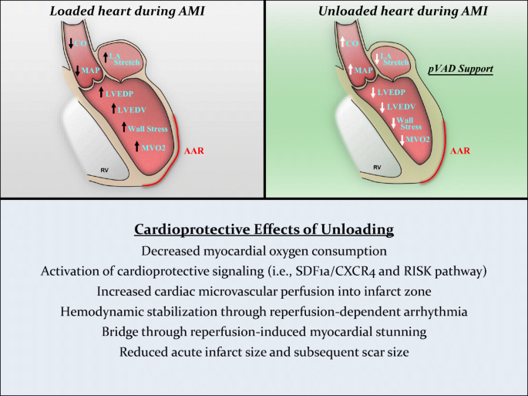
How Would You Treat?
D) Left Side Mechanical Support (Left Impella)
Curran, J., Burkhoff, D. & Kloner, R.A. Beyond Reperfusion: Acute Ventricular Unloading and Cardioprotection During Myocardial Infarction. J. of Cardiovasc. Trans. Res. 12, 95–106 (2019). https://doi.org/10.1007/s12265-019-9863-z

Slide 35
Tips and Tricks
Pressure does not accurately reflect flow when vascular impedance is abnormal
Remember complications that can impact cardiogenic shock
Most patients will have multiple co-morbidities complicating their care
Respiratory variation, PEEP, Mechanical ventilation all effect hemodynamics
Consider evaluating CPO and PAPi in addition to other hemodynamics

Slide 36

Thank You

